Slide 2
HTML5 & CSS3
Pradeep B V
Y! Media
@pradeepbv
http://www.slideshare.net/pradeepbv

Slide 3
Web standards today
HTML
HTML 4.01 Specification
W3C Recommendation 24 December 1999
JS
ECMA-262 3rd edition
November 2000
CSS
CSS Level 2 Specification
W3C Recommendation May 1998

Slide 4
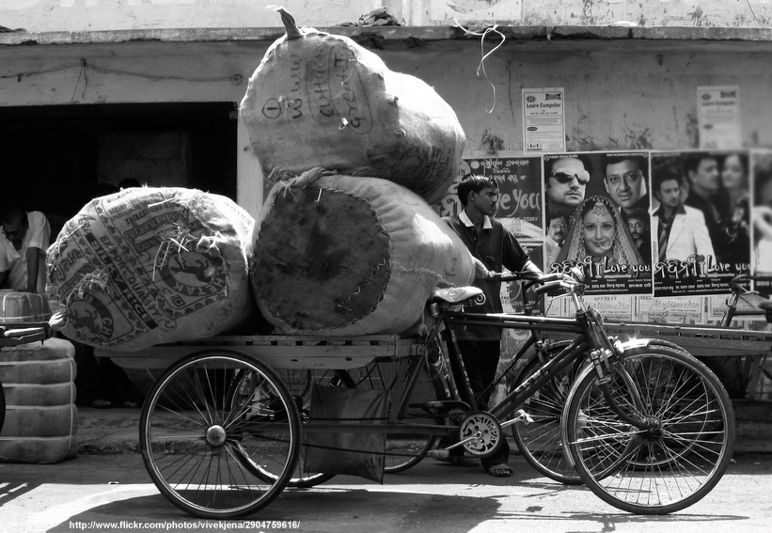

Ailing , over burdened & cracking at the edges
http://www.flickr.com/photos/vivekjena/2904759616/

Slide 5
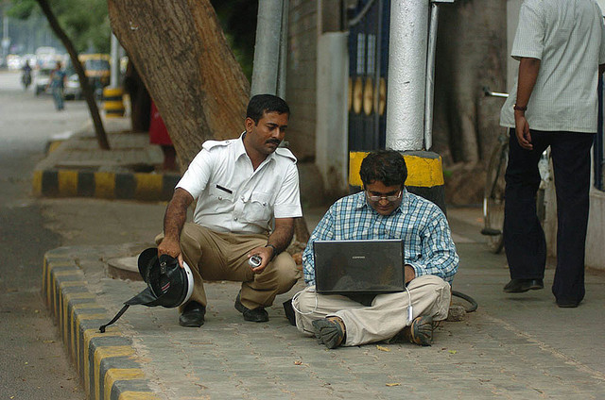

Who can help us?
http://www.flickr.com/photos/ananthask/3092896908

Slide 6










Slide 7

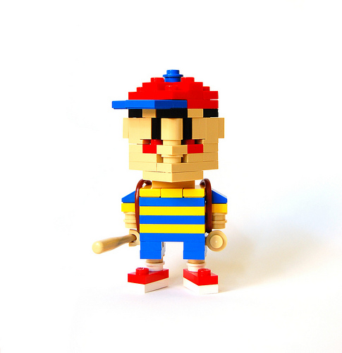
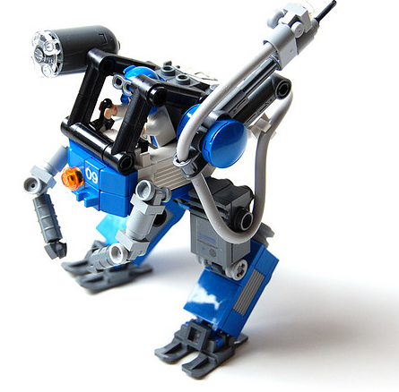
Html5 = ???
Html5 markup + js api’S + css3
http://www.flickr.com/photos/gladius/with/2304942509/

Slide 8
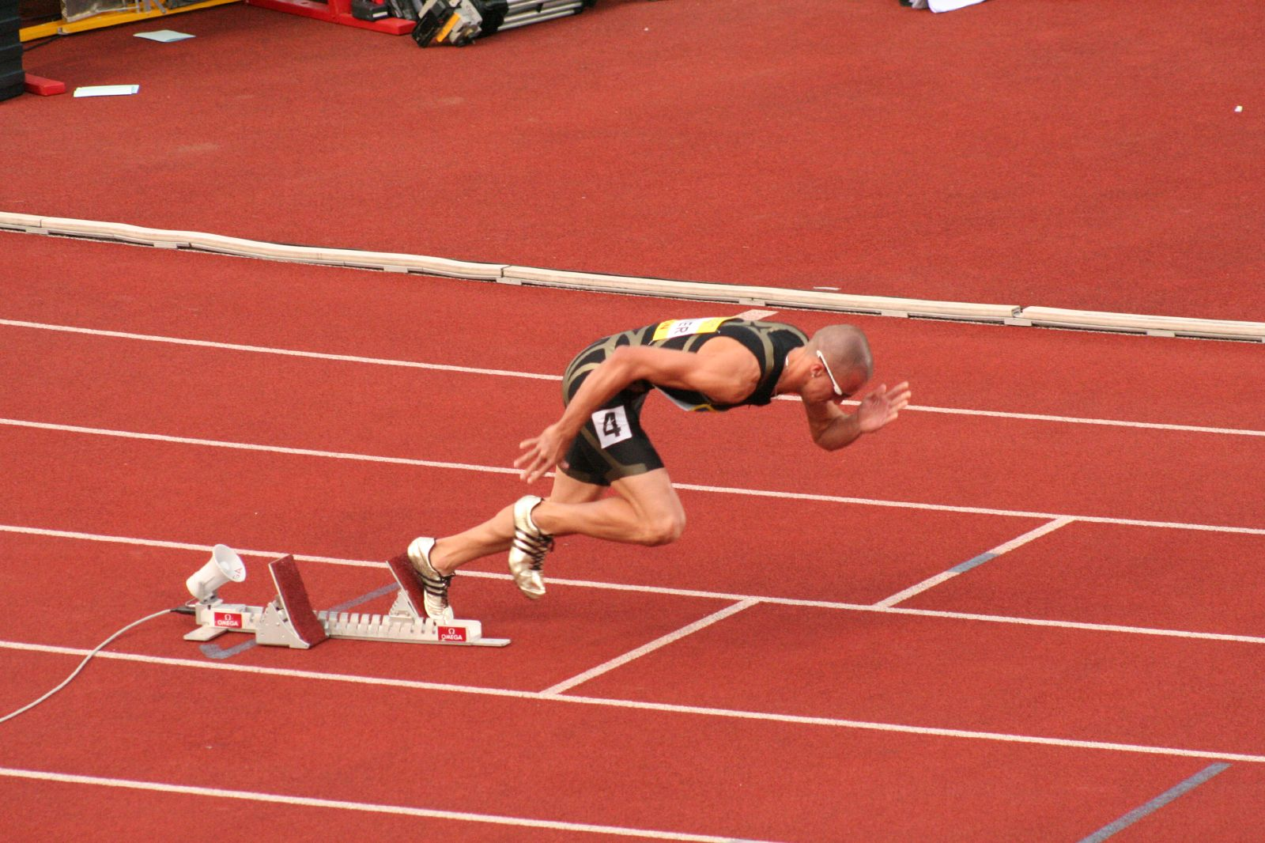
It already running out there
http://www.flickr.com/photos/philmcelhinney/1000986005/

Slide 9
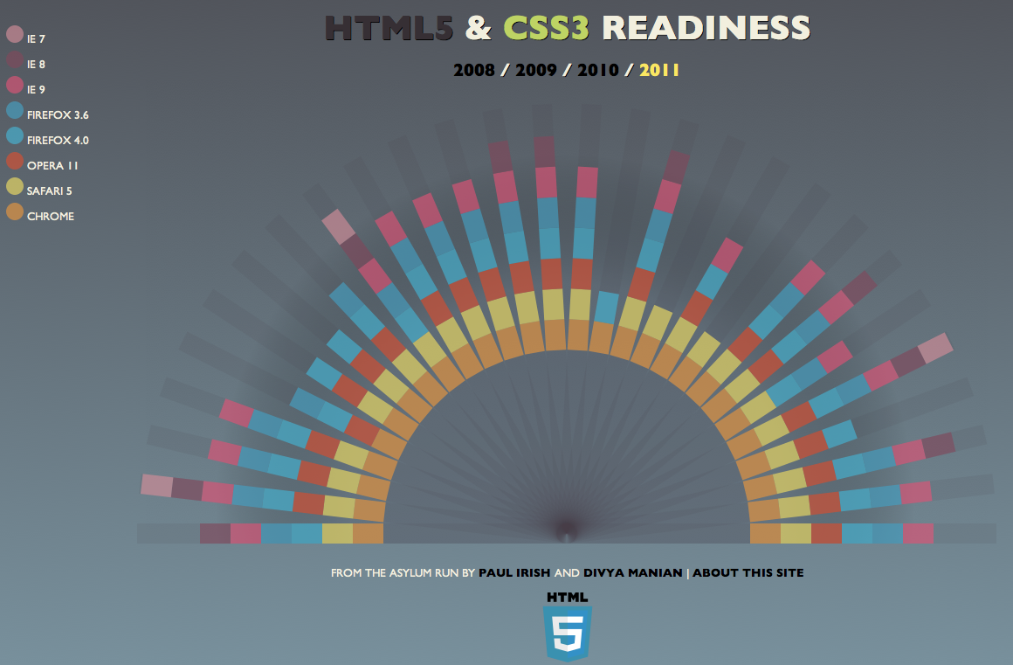
http://html5readiness.com/

Slide 10


Slide 11
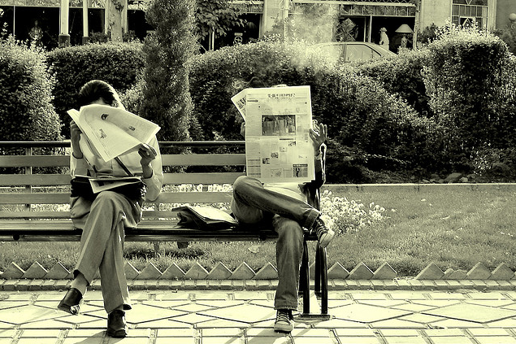


HTML 5 SEMATICS
<!DOCTYPE html PUBLIC "-//W3C//DTD XHTML 1.0 Strict//EN" "http://www.w3.org/TR/xhtml1/DTD/xhtml1-strict.dtd">
http://www.flickr.com/photos/hamed/512309138/
<!doctype html>
http://www.flickr.com/photos/yourdon/3475417696/
http://www.flickr.com/photos/johanl/4816110696/in/photostream/

Slide 12
HTML 5 SEMATICS
<meta http-equiv="Content-Type" content="text/html; charset=UTF-8">
http://www.flickr.com/photos/hamed/512309138/
<meta charset=“utf-8">
http://www.flickr.com/photos/yourdon/3475417696/
http://www.flickr.com/photos/johanl/4816110696/in/photostream/

Slide 13
HTML 5 SEMATICS
<link rel="stylesheet" type="text/css" href=“style.css"></link>
http://www.flickr.com/photos/hamed/512309138/
<link rel="stylesheet” href=“style.css"></link>
<script></script>
http://www.flickr.com/photos/yourdon/3475417696/
http://www.flickr.com/photos/johanl/4816110696/in/photostream/

Slide 14

better SEMATICS
<header>
<nav>
<article>
<aside>
<article>
<article>
<footer>
http://www.flickr.com/photos/zooboing/4183276288/

Slide 15

Some new elements
<figure> & <figcaption>
<mark>
<meter>
<progress>
<details> & <summary>
<time>
<datalist> & list
Some new Attributes
contenteditable
contextmenu
dragable
role
on??? (e.g. onclick)
http://www.flickr.com/photos/hygienematters/5424756879

Slide 16
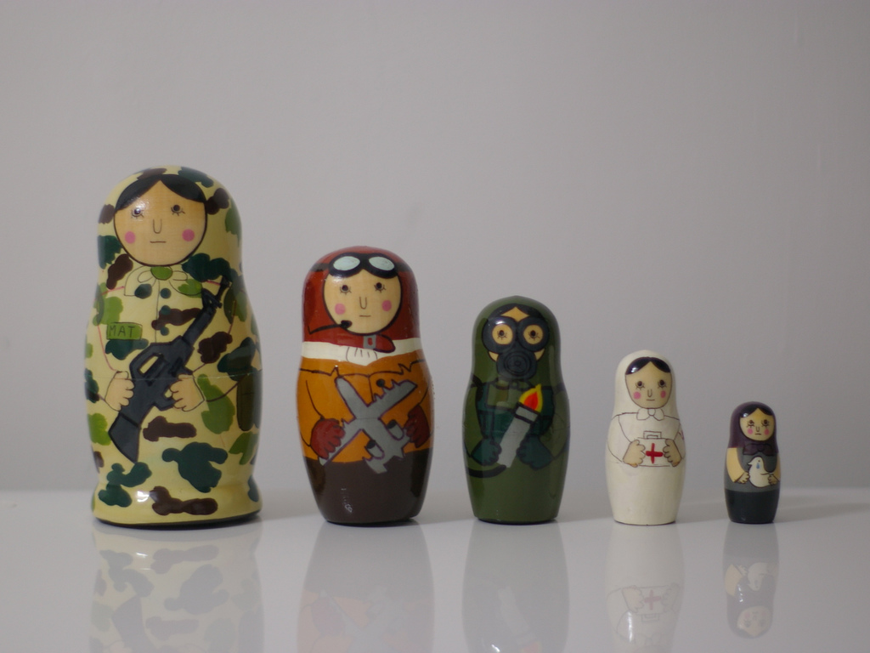
Custom Attributes
<div id=“ticker” data-symbol=“YHOO”>
el.getAttribute(attrName)
http://www.flickr.com/photos/tamakisono/531582453

Slide 17

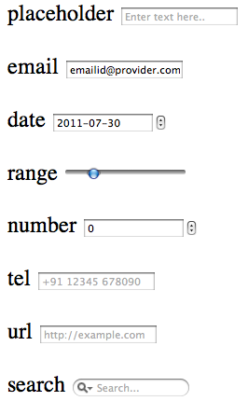
New form types
more at: http://diveintohtml5.org/forms.html
http://www.flickr.com/photos/wwworks/2475349116

Slide 18
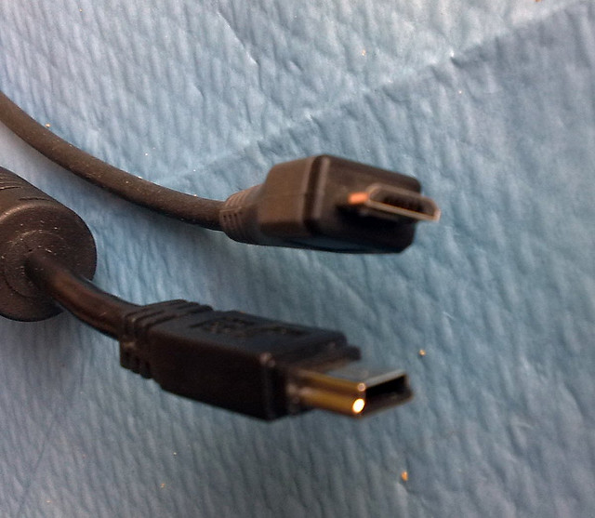
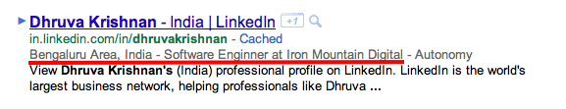
Microdata
Semantic web pages
Annotate the DOM with
scoped key/value pair from
custom vocabularies
http://www.flickr.com/photos/osde-info/3189305118/

Slide 19


Slide 20
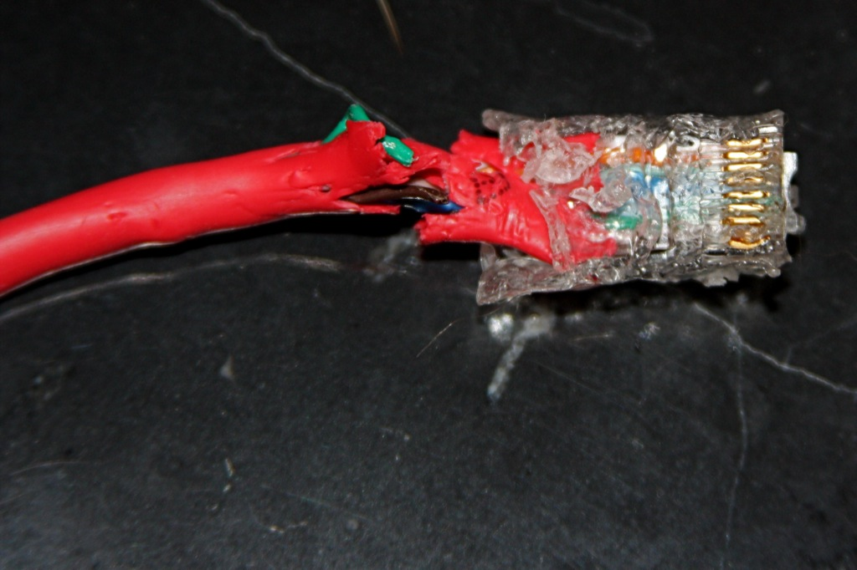
Networks break
http://www.flickr.com/photos/rothwerx/2641452698

Slide 21
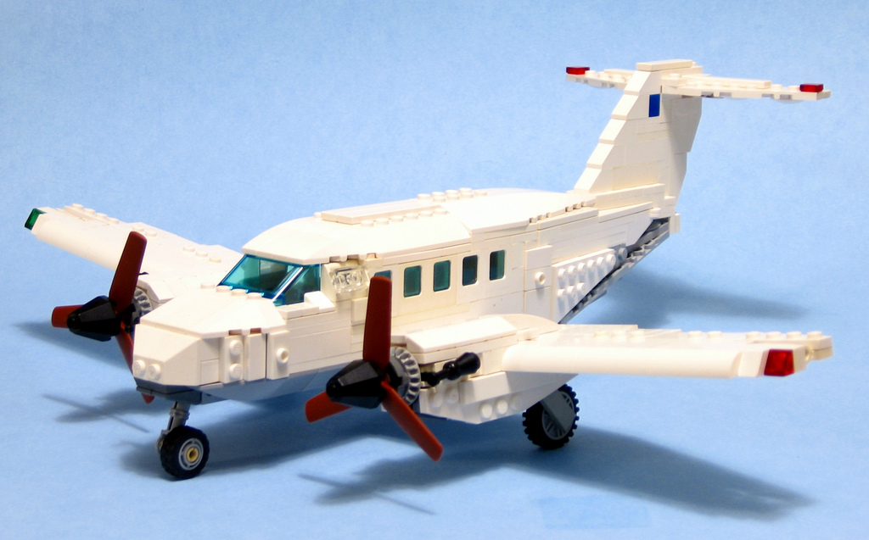

Devices go on airplane mode
http://www.flickr.com/photos/pmiaki/3635074858

Slide 22
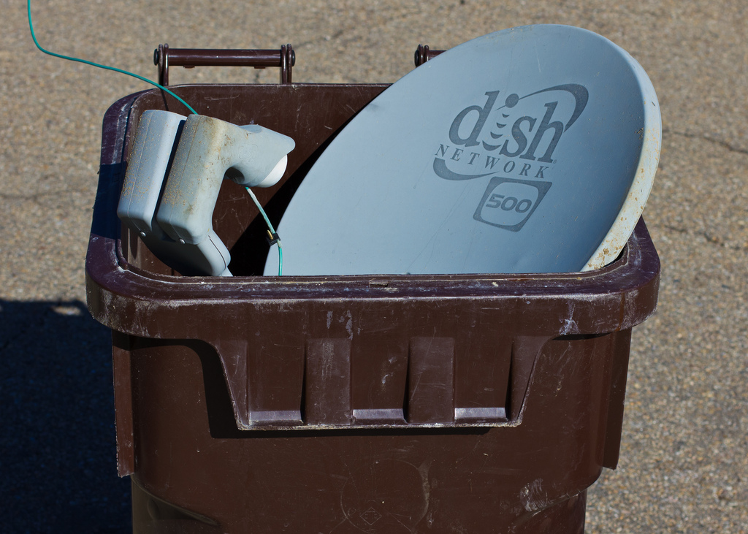
<html manifest="/cache.manifest">
CACHE MANIFEST
index.html
style.css
Script.js
Network:
api.webservice.example.com
http://www.whatwg.org/specs/web-apps/current-work/multipage/offline.html
http://www.flickr.com/photos/teegardin/5894050552

Slide 23
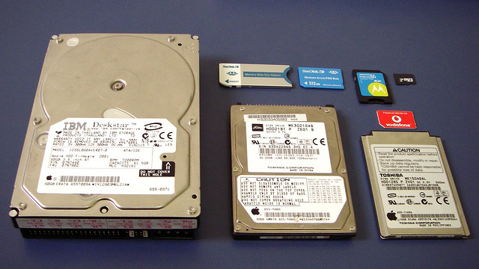
STORAGE
http://www.flickr.com/photos/teegardin/5894050552

Slide 24

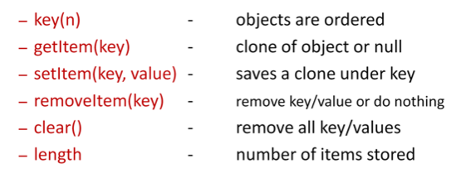
Storage API
sessionStorage :
tied to the life of the session (browser window close)
localStorage :
is stored indefinitely
More: http://html5demos.com/storage/
http://www.flickr.com/photos/bfionline/2378518052

Slide 25


Slide 26

Hisroty API
window . history . pushState(data, title [, url ] )
window.addEventListener("popstate", function(event) {
set(event.state);
}
http://diveintohtml5.org/history.html
http://www.flickr.com/photos/archetypefotografie/3821120232

Slide 27
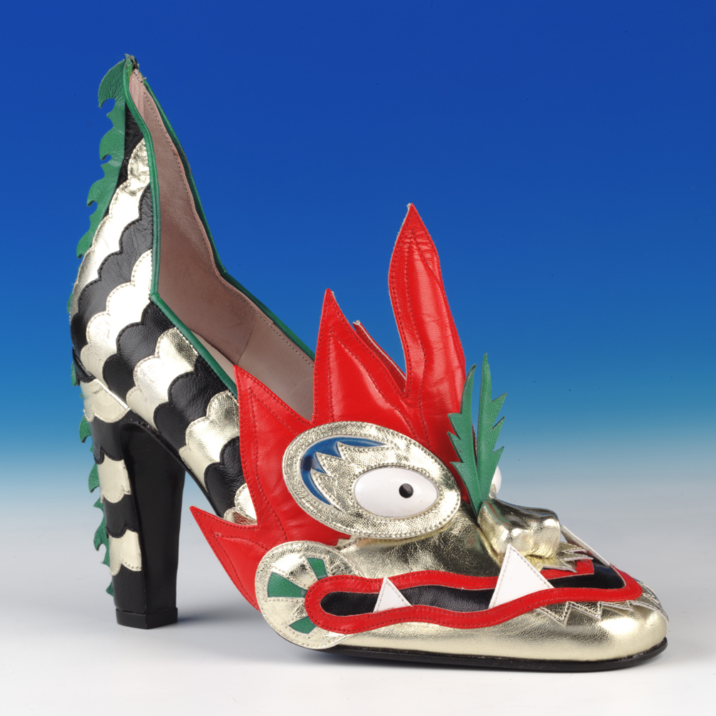
Drag and drop
http://www.flickr.com/photos/northampton_museum/3968334205

Slide 28
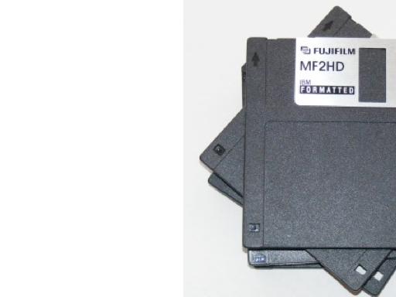
File API
File API
Use JS to
Read file
Monitor read progress
Slice file
http://html5demos.com/file-api
http://www.flickr.com/photos/free-stock/4817557432/

Slide 29
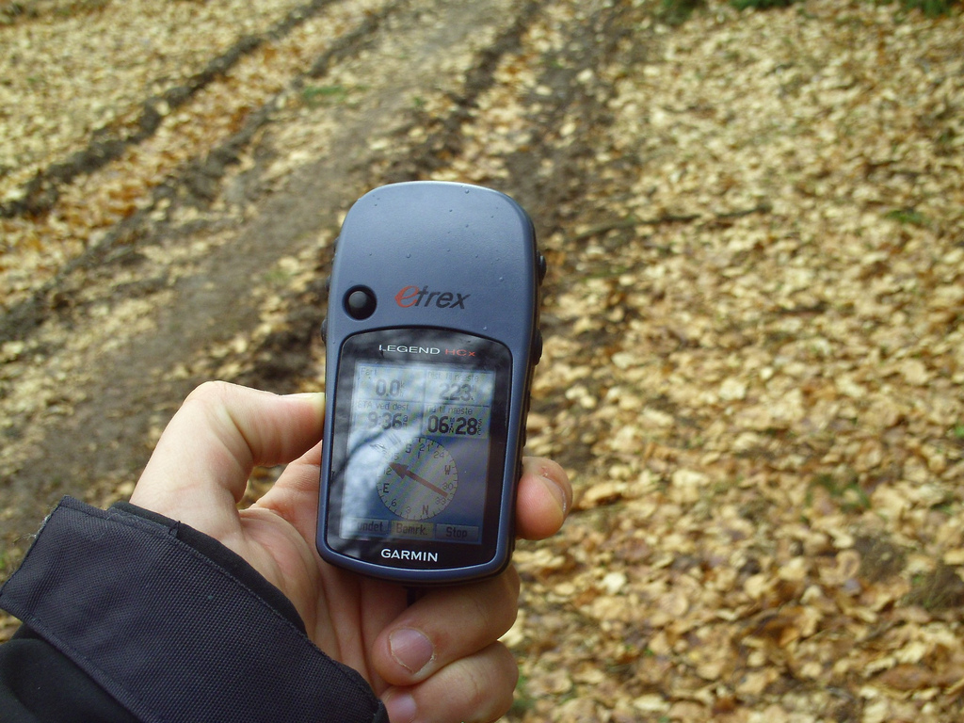
Geo location
if (navigator.geolocation)
navigator.geolocation.getCurrentPosition(success, failure,
{maximumAge: 4800});
coords.latitude
coords.longitude
coords.altitude
coords.accuracy
coords.altitudeAccuracy
coords.heading
coords.speed
timestamp
http://www.flickr.com/photos/geocacherdk/3359109398

Slide 30
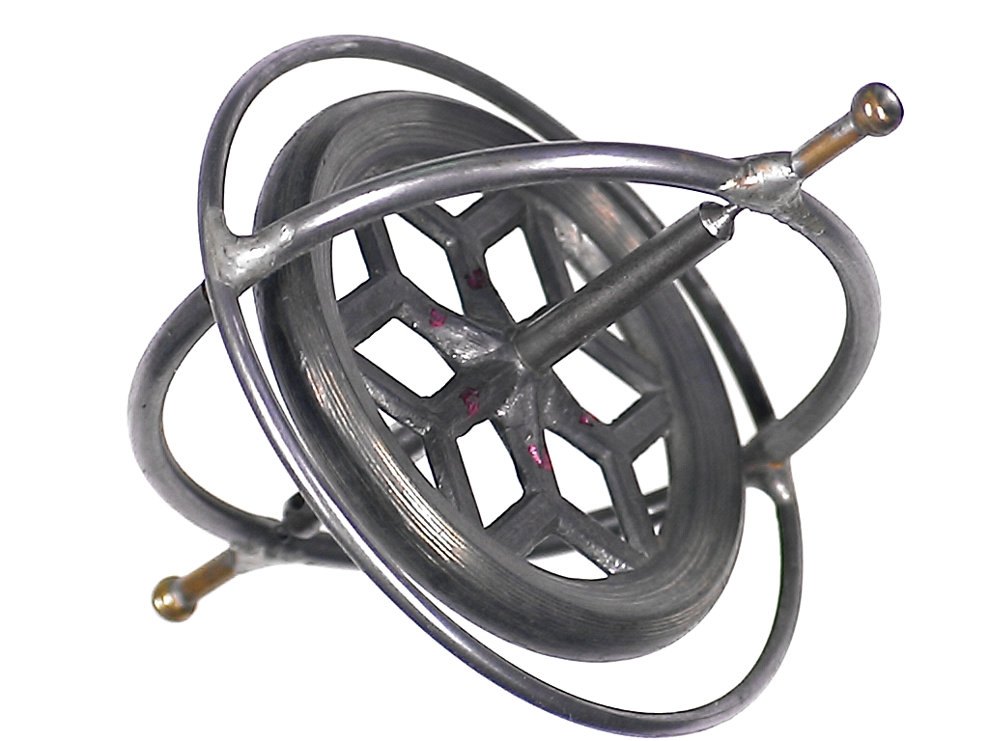
File API
Device Orientation
window.addEventListener("deviceorientation", function(event) {
// process event.alpha, event.beta and event.gamma
}, true);
http://pradeepbv.github.com/openhackday2011/device_orientation_demo.html
http://dev.w3.org/geo/api/spec-source-orientation.html
http://www.flickr.com/photos/lofink/415275746

Slide 31
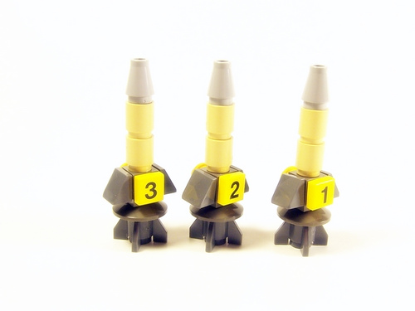
Other things on the launch pad…
audio/video input, access microphones and cameras,
local data such as contacts & events
http://www.flickr.com/photos/gladius/162647178

Slide 32


Slide 33
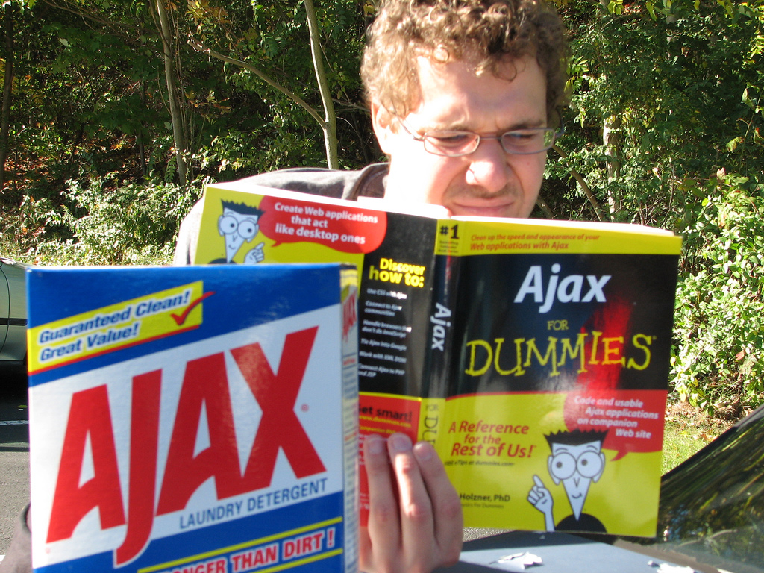
Ajax 2.0!
http://www.flickr.com/photos/daveynin/1672745911

Slide 34
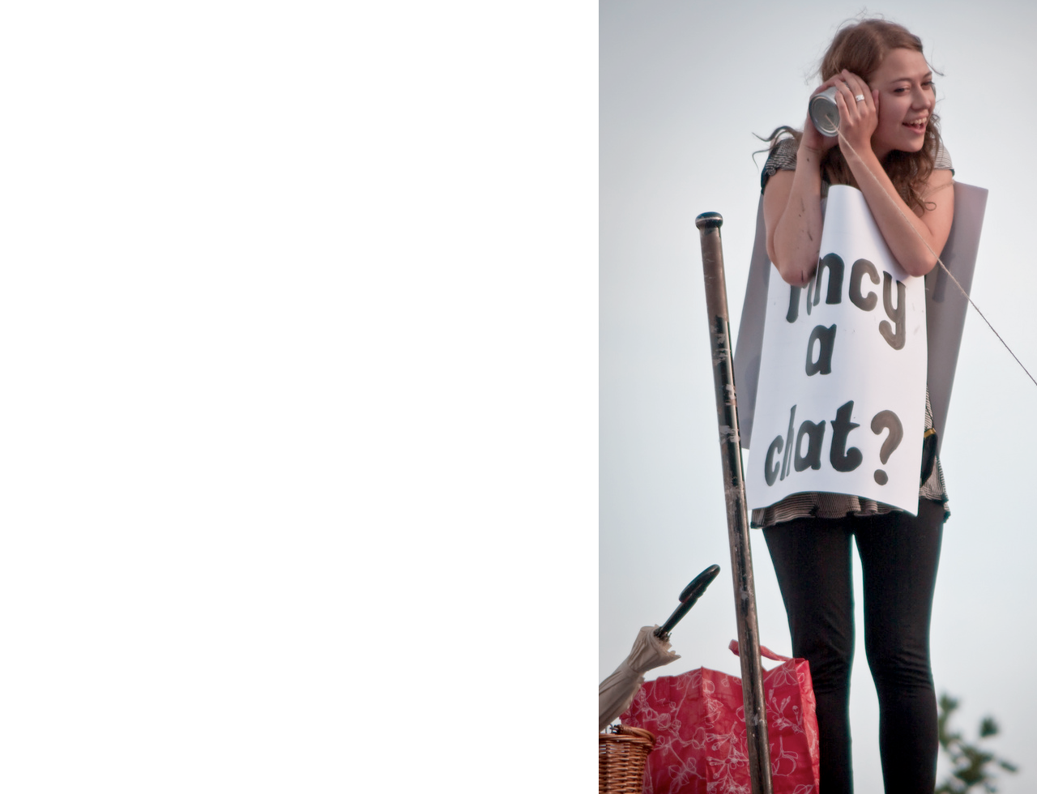

Cross-Origin
Resource Sharing
XHR request across domains
if the server you are
connecting to allows it
<?php
header('Access-Control-Allow-Origin: *');
?>
myproxy.php
<?php
$url = $_SERVER['QUERY_STRING'];
$ch = curl_init($url);
curl_exec($ch);
?>
http://www.flickr.com/photos/garryknight/3861083969/

Slide 35
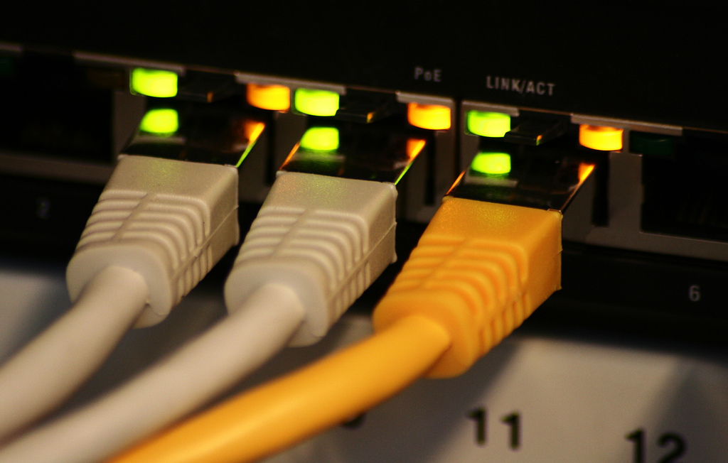

Websockets
full-duplex
Reduced latency ☺
Gaming
http://www.flickr.com/photos/triller/2226679393/

Slide 36


Slide 37
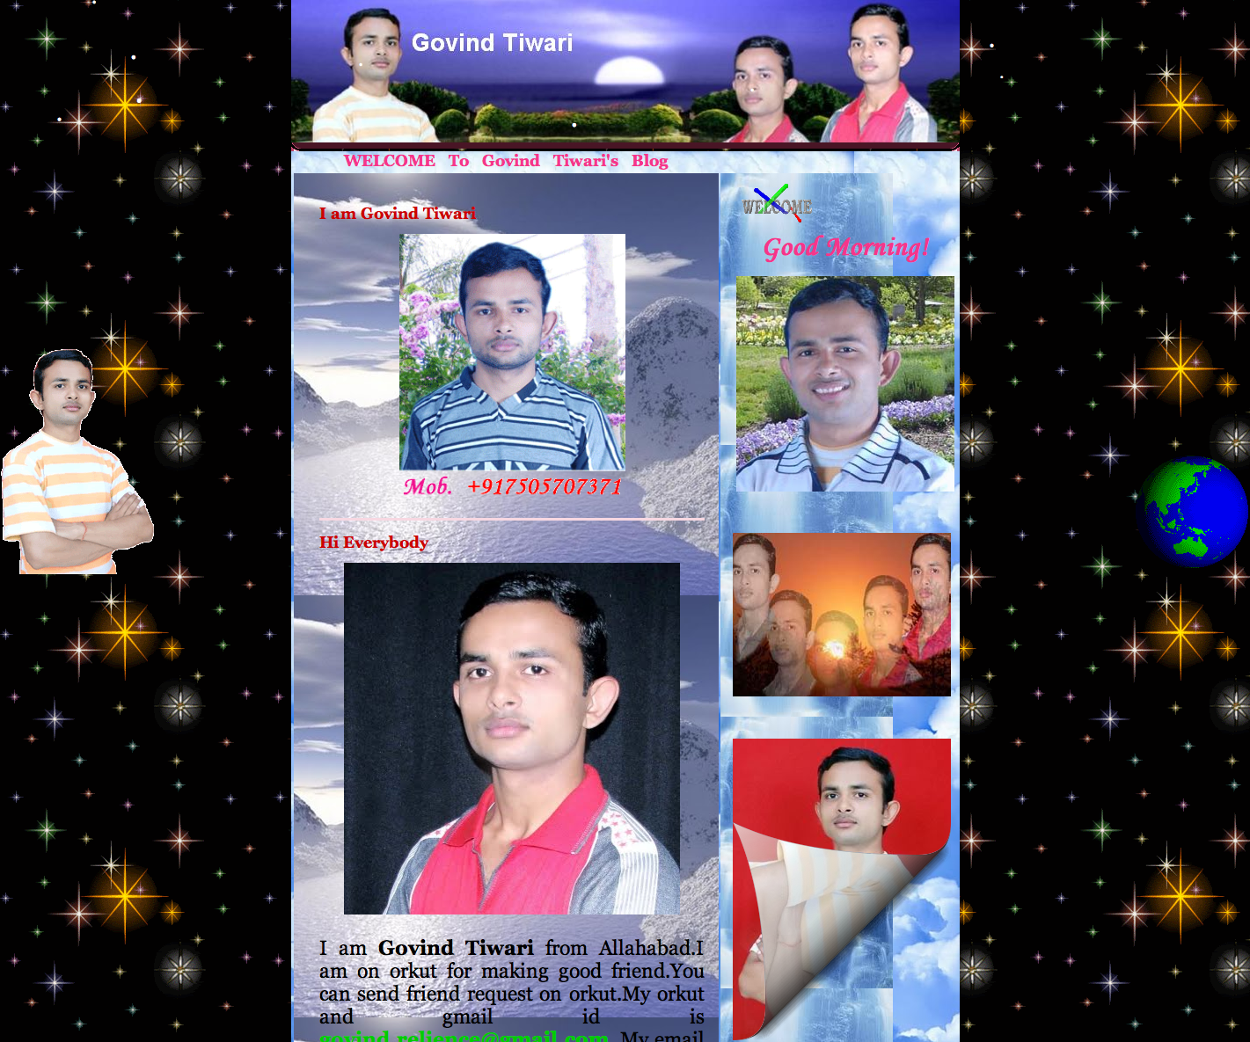
http://govindtiwari.blogspot.com/

Slide 38

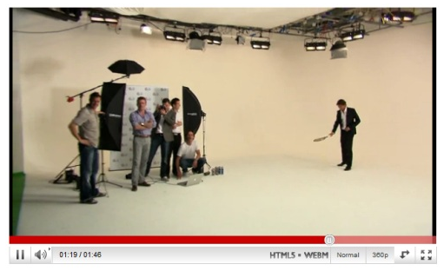
<video> - audio, autoplay, control, height, loop, poster, preload, src, width
<video width="320" height="240" controls="controls">
<source src="movie.ogg" type="video/ogg" />
<source src="movie.mp4" type="video/mp4" />
<source src="movie.webm" type="video/webm" />
</video>
http://www.flickr.com/photos/lge/3810270838/, http://googlesystem.blogspot.com/2010/08/watch-video-in-youtubes-html5-player.html

Slide 39
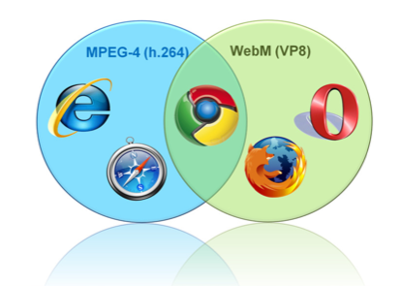
Video

Slide 40
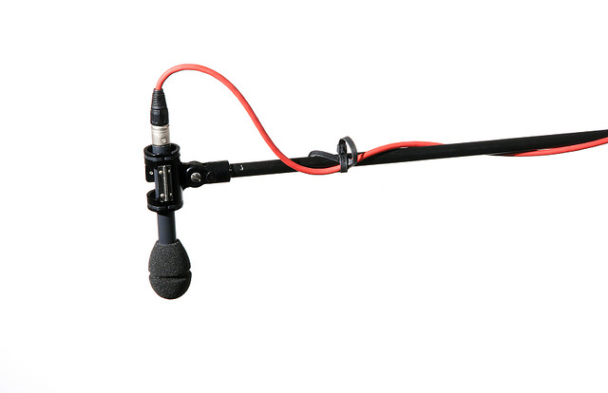

Audio
autoplay, controls, loop, preload, src
<audio controls="controls">
<source src=”mysong.ogg" type="audio/ogg" />
<source src=”mysong.mp3" type="audio/mpeg" />
</audio>
http://www.flickr.com/photos/17258892@N05/2587506121/

Slide 41


Slide 42

WEBGL
http://chrome.angrybirds.com/

Slide 43

canvas
http://www.canvasdemos.com/
http://www.flickr.com/photos/lisa-parker/5438529653

Slide 44


Slide 45

Web workers
http://www.flickr.com/photos/striatic/1276095

Slide 46
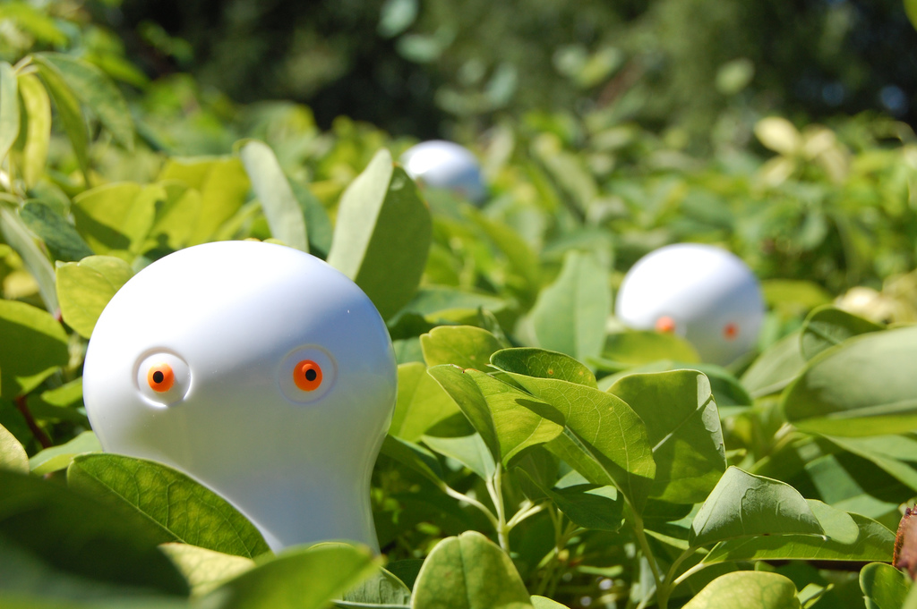
Web workers
Carry out
expensive computations
network calls
without interrupting the UI
http://pradeepbv.github.com/openhackday2011/web_workers_demo.html
http://www.flickr.com/photos/gladius/1240719073

Slide 47
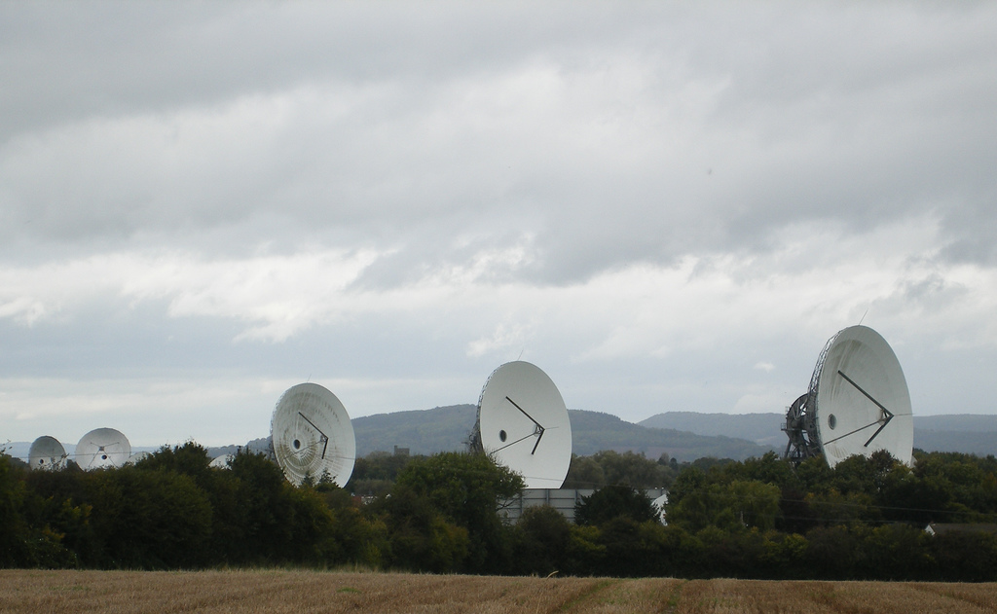
Messaging
.postMessage(str)
.onMessage(event)
event.data ==str
document
.getElementById(“iframeid”)
.contentWindow
.postMessage(“my message”)
http://www.flickr.com/photos/sparker/2949114977

Slide 48


Slide 49
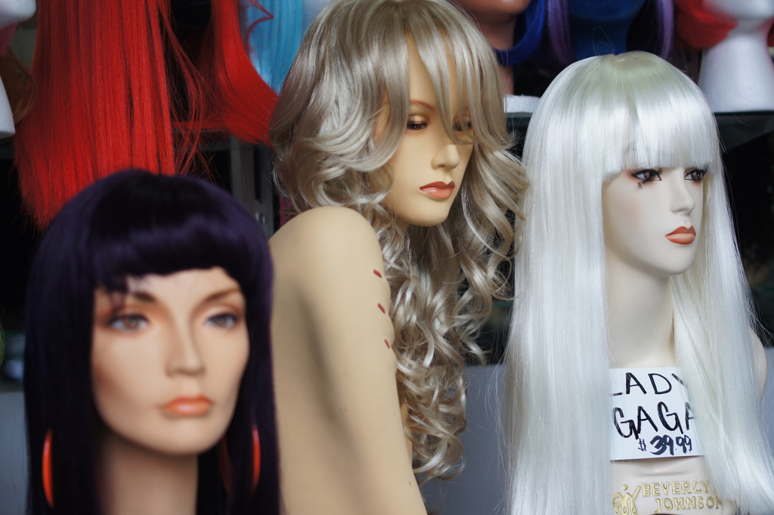
Style up using CSS3
http://www.flickr.com/photos/pdenker/5386861946/

Slide 50
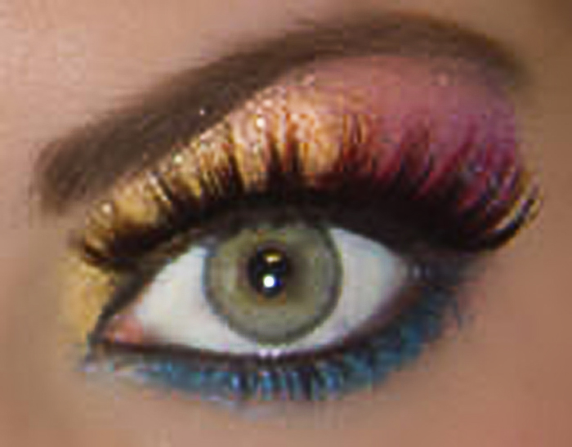
Follow fashion trends
Gradient
Rounded Corners
Shadow
http://www.flickr.com/photos/pumpkincat210/3339791794

Slide 51
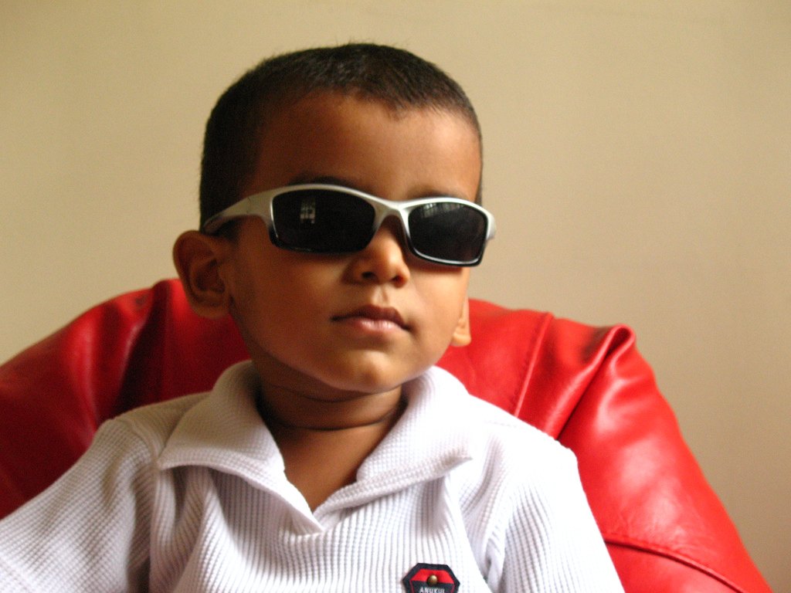
Lets see styles
http://css3please.com
http://www.flickr.com/photos/balamurugan/655338758/

Slide 52

CSS selectors
http://tools.css3.info/selectors-test/test.html
http://in.movies.yahoo.com

Slide 53

Web Fonts
http://pradeepbv.github.com/openhackday2011/web_font_demo.html

Slide 54

Draft Documents
http://dev.w3.org/html5/
http://whatwg.org/html
http://www.flickr.com/photos/42931449@N07/5263540555

Slide 55
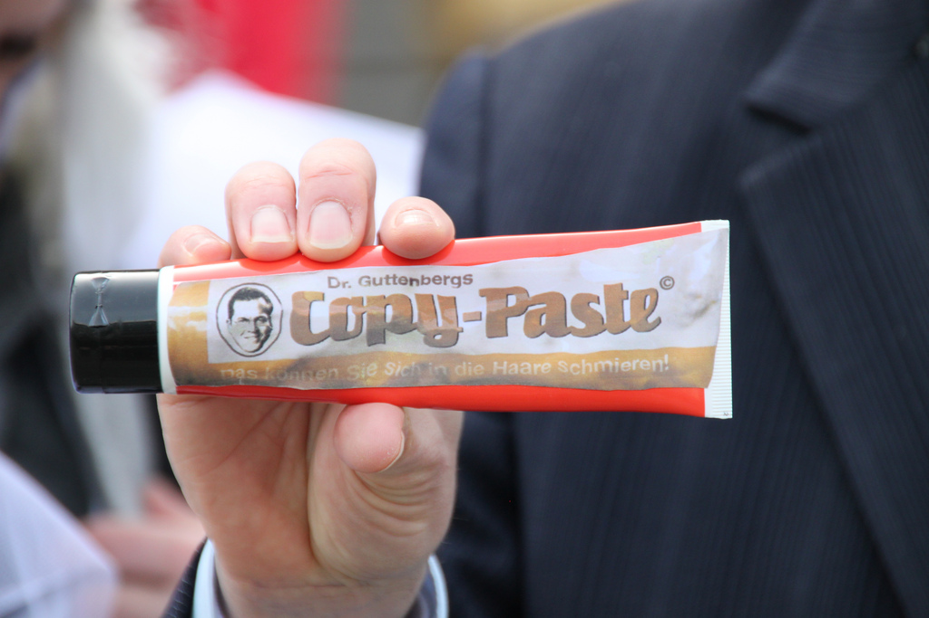
Copy, paste, tweak, profit!
http://html5demos.com/
http://www.flickr.com/photos/avatar-1/5499235063

Slide 56
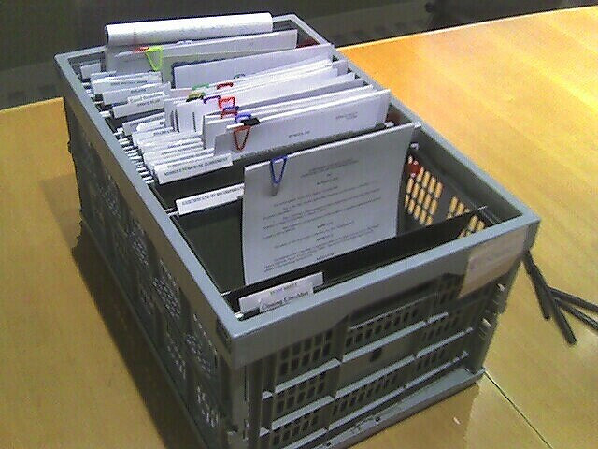
Ready recokner
http://slides.html5rocks.com
http://www.flickr.com/photos/ifindkarma/112531388

Slide 57

http://caniuse.com/
http://www.flickr.com/photos/f-oxymoron/5005146417

